Slide 1
Data PX1 – UI

Slide 2
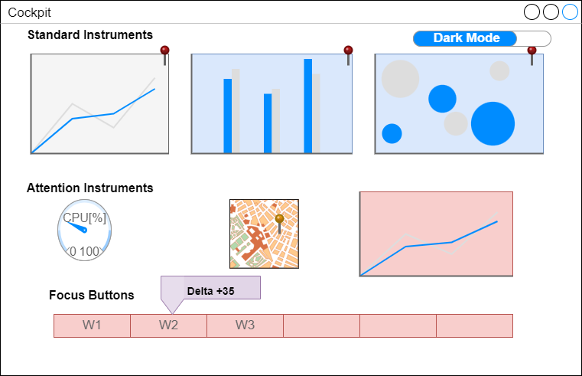
Standard Instruments are selected by the user to be displayed all the time.
Standard Instruments are selected by the user to be displayed all the time.
Click will open the Widget
Attention Instruments are selected by the system as something to be looked at.
Focus Buttons show things that need to be looked at now. Hovering shows relevant numbers,

Slide 3
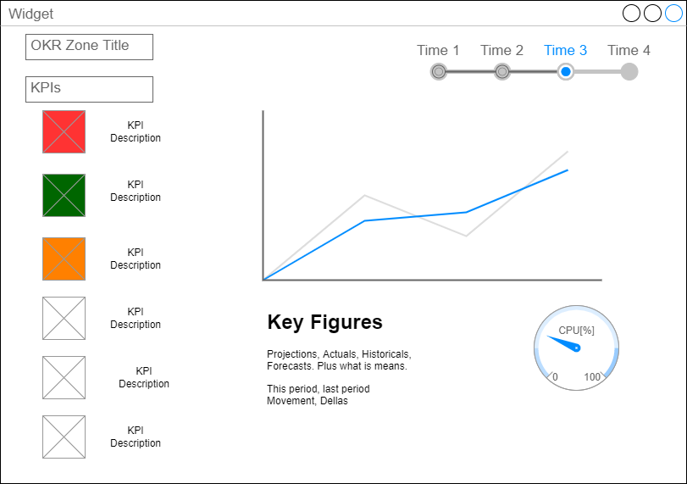
RAG
style
Click shows Definitions

Slide 4
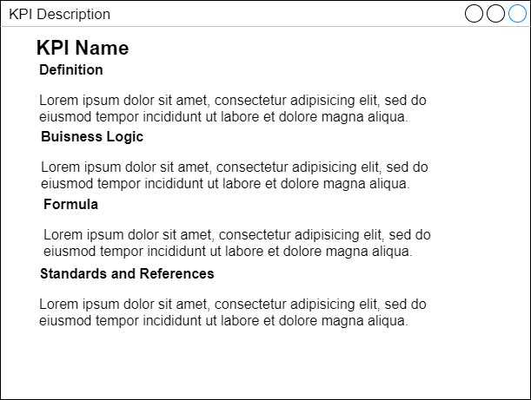
KPI Definitions

